Slide 1
Internal Presenter Notes: What Attendees Should Take Away
How to build a modern data warehouse on Azure
How Azure services work together to deliver MDW and Cloud Scale Analytics
The evolution of Cloud Scale Analytics on Azure
Notes:
PRESENTER NOTES AND GUIDANCE
The world of modern data warehousing and cloud scale analytics is complex.
If you don’t have the skills measured in the Microsoft Certified: Azure Data Engineer Associate role-based certification, you’ll be spending a significant time in preparing for this session.
Our guidance is that you either qualify or have passed the certification exams and have real world experience implementing cloud scale analytical solutions.
This presentation deck has talking points on each slides, and we encourage you to be strongly familiar with them.
At the bottom section of most slides, you’ll find additional guidance in order for you to successfully prepare and deliver the sessions as part of this learning path.

Slide 2
Designing a modern data warehouse solution
Speaker name
Title
Notes:
TALKING POINTS
Introductions: Hi, my name is <speaker name> and in this session, Modern Data warehousing and Cloud Scale Analytics, we are going to walk through the business challenges resolved by modern data warehousing and cloud scale analytics. We’ll have a detailed conversation about common challenges, typical data warehousing patterns, and how Microsoft Azure provides you with scalable solutions for data warehousing and cloud scale analytics.
As a presenter, I encourage you to think about these scenarios apply to your own, or your customers business problems, and how you see the potential of how you can help providing better insights through Cloud Scale Analytics.
I appreciate and welcome questions <pick your own preference here>:
During my presentation
During the presentation, but realize that not all your questions might be addressed, so might defer you to the Q&A section of this presentation
At the end of the presentation

Slide 3
Resources
Session Resources Hub
aka.ms/DATA10
Session Code on GitHub
aka.ms/DATA10Repo
All Event Session Resources
aka.ms/mymsignitethetour
Notes:
TALKING POINTS
In the session, we’ll have demo assets that you would be able to use afterwards for your own learning and exploration.
I encourage you to look at those, capture and review them later.

Slide 4
Agenda
Why Modern Data Warehousing?
Building the Modern Datawarehouse
Advanced Analytics Patterns
The evolution of Cloud Scale Analytics
Notes:
TALKING POINTS
In this session well cover a set of topics that will increase your understanding on how to build modern data warehousing, explore different patterns .
We’ll drill down into trends, usage patterns, how to build a modern data warehouse and how to perform cloud scale analytics in Microsoft Azure. At the end we’ll also have a look at the evolution of cloud scale analytics.

Slide 5
Why modern data warehousing?
Notes:
TALKING POINTS
In this session we’ll talk about the use case scenario of a company named Tailwind Traders.
Tailwind Traders, like many other companies is driving digital transformation to get actionable insights from their data.
To drive business impact and intelligent decision making, they are taking advantage of a modern data warehouse to build a cloud-scale analytics solution.
Digital transformation & Data Estate Modernization, it’s the topic of the day, and for a good reason! It’s here to stay, It’s a phenomenon that is actively fueling both the success and the failure of every organization.
So let’s have a look

Slide 6


Digital
transformation
91%
of business leaders see Digital Transformation as a way of sparking innovation and finding efficiencies
68%
say Digital Transformation is increasing profits
85%
say they must offer digital services or become irrelevant
64%
say they have less than 4 years to complete a Digital Transformation or they may go out of business
Notes:
TALKING POINTS
Some organizations are embracing a digital transformation journey and feel excited about it…and we see organizations are reaping real, tangible rewards. The positive disruptions are truly amazing.
But we also acknowledge that for some, the whole topic of digital transformation is causing tension. There are legitimate concerns about getting ‘digital transformation’ right and in truth, future success does depend on making this transition.
So… let’s step back a moment. There are some things that can help demystify the whole topic a bit…to help you think about it differently.
(optional statistics for visualization or as embedded talking points:
Positives:
91% of business leaders see DT as a way of sparking innovation and finding efficiencies
68% say DT is increasing profits
Negatives:
85% say they must offer digital services or become irrelevant
64% of business leaders say they have less than 4 years to complete a DT or they may go out of business
1. Research Report | ISACA, Information Systems Audit and Control Association | 2018
Nine in 10 enterprises (91 percent) are attempting digital transformation as they look to spark innovation and explore efficiencies
2. Survey | DXC Technology and the Economist Intelligence Unit | 2019
68% of respondents say their organization’s annual profitability has increased over the past three years thanks to its digital strategy and 74% say they expect it to rise over the next three years
3. Survey | Couchbase | August 2018
85 percent of respondents said disruption in their industry has accelerated over the past 12 months, and 86 percent believe businesses will have to adapt to providing digital services in the next 12 months, or accept they will become less relevant
4. Survey | Couchbase | August 2018
64 percent believe those that can’t keep up with digital innovations will go out of business or be absorbed by a competitor in fewer than four years

Slide 7
Common challenges with on-premises solutions
Data Silos
Performance Constraints
Solution Complexity
Escalating Costs
Notes:
TALKING POINTS
So let’s spend a moment identifying what prevents companies from capitalizing on that data growth?
Historically there have been challenges with on-premises solutions.
Data exists in silos: There are all sorts of data coming in, stored across databases that power the applications or lifeblood of a company, data from sensors and devices, external data sources from media, and more. But harnessing that data is difficult and costly. Furthermore, connecting that data in ways that drives deeper insights poses even greater challenges.
Performance constraints: On-premises systems reach capacity. Customers are having to make strategic decisions about how to scale and how to do it cost effectively.
Complexity of solutions: Over time, companies have adopted a variety of products or solutions to solve specific business needs. They now find that they have a diverse set of tools, on premise and in the cloud, all with their unique tool sets and cost models, and skill sets requires to use them. It is hard to skill up and scale these offerings for the whole company to take advantage of, and costing is no longer transparent…the invoice has many line items to manage.
This comes to rising costs. Scaling up and adding hardware, paying for multiple toolsets that have some overlapping capabilities but lacking the scale, or ubiquity to do more than a purpose driven task well, and hiring resources with the specific skills needed adds up. And suddenly, companies looking to get ahead and maximize ROI with data are finding it challenging to harness it for transformation.
PRESENTER NOTES AND GUIDANCE
Use this slide as an opportunity to learn about your audience. Many; if not all, will have on-premises solutions such as Line of Business (LOB) applications with supporting databases hosted in technologies such as SQL Server, or on premises legacy data warehouses.
Each of these challenges will be recognizable to them.

Slide 8
Derive real value from your data in the cloud
One hub for
all data
Unlimited
data scale
Common Platform
Lower TCO
Notes:
TALKING POINTS
To derive real value from your data, you require a comprehensive platform with familiar tools and a robust ecosystem of partners and ISVS to deliver the solutions you need at cloud scale
One hub for all data: This is one of the most significant pain points we hear from customers. How can I get access to all of the data internally and externally to my organization. Each system needs its own database, that is true. Microsoft’s analytics solution is able to connect to those data sources and bring that data into a cloud scale data warehouse solution for deriving insights, from a variety of data sources.
Unlimited data scale: Not only can Microsoft’s solution process these diverse types of data, it can do it at scale, without constraints typically associated with existing on premises solutions.
Familiar tools and ecosystem: And, you don’t have to hire a number of specialists to manage a niche tool. Microsoft’s offerings provide familiar tools and ecosystem to help you leverage your investment quickly.
Lower TCO: The benefits noted all accrue to a lower TCO.

Slide 9

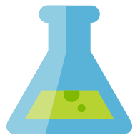
Common customer use cases
Modern data warehouse
Advanced analytics
Real-time analytics
“Integrate all our data—including Big Data—with our data warehouse for analytics and reporting”
“Predict next best offer and customer churn”
“Derive insights from our devices and data streams in real-time”
Notes:
TALKING POINTS
Across all organizations and industries, common use cases are identified by the need for:
Modern data warehousing: The ability to integrate all data, including big data, with the ability to reason over data for analytics and reporting purposes, and reason over data, independent of its location or structure
Advanced Analytics – go beyond the area of reporting, and driving analysis and turn your wealth of data into the ability to “predict what happens next”
Real time Analytics –capture, store and analyze data in real-time or near-real time

Slide 10
Building the modern data warehouse
Notes:
TALKING POINTS
So let’s have a detailed look on how we go about building a modern data warehouse

Slide 11
Modern data warehouse patterns
Modern data warehouse
Advanced analytics
Real-time analytics
“Integrate all our data—including Big Data—with our data warehouse for analytics and reporting”
“Predict next best offer and customer churn”
“Derive insights from our devices and data streams in real-time”
Notes:
TALKING POINTS
Across all organizations and industries, common use cases are identified by the need for:
Modern Data Warehousing: The ability to integrate all data, including big data, with the ability to reason over data for analytics and reporting purposes
One hub for all data: This is one of the most significant pain points we hear from customers. How can I get access to all of the data internally and externally to my organization. Each system needs its own database, that is true. Microsoft’s analytics solution is able to connect to those data sources and bring that data into a cloud scale data warehouse solution for deriving insights, from a variety of data sources.
Unlimited data scale: Not only can Microsoft’s solution process these diverse types of data, it can do it at scale, without constraints typically associated with existing on premises solutions.
Familiar tools and ecosystem: And, you don’t have to hire a number of specialists to manage a niche tool. Microsoft’s offerings provide familiar tools and ecosystem to help you leverage your investment quickly.
Lower TCO: The benefits noted all accrue to a lower TCO.

Slide 12

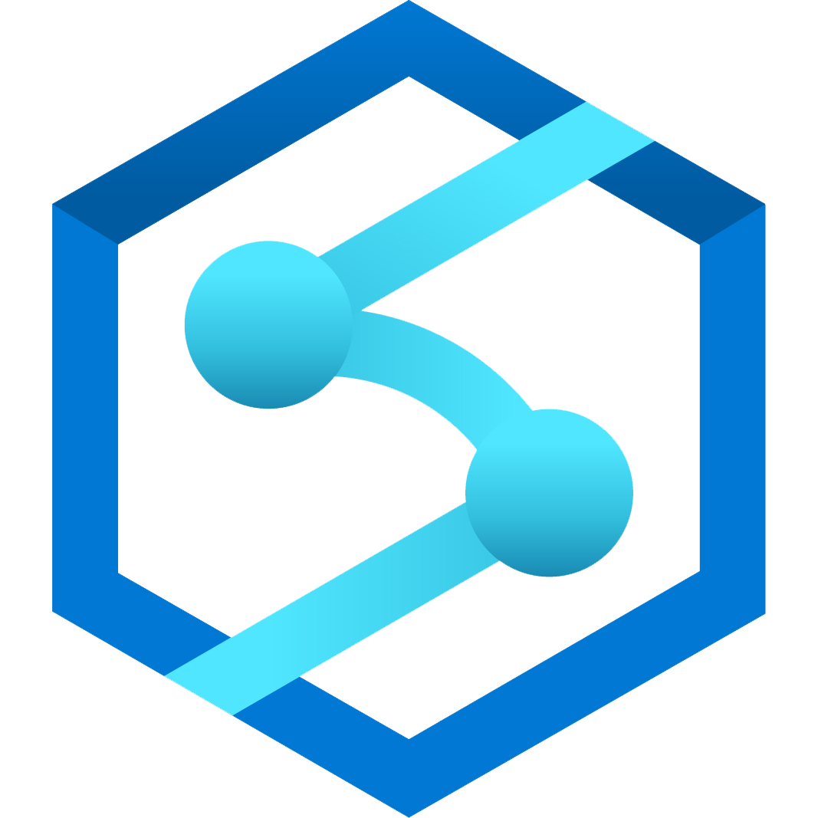

Modern data warehousing patterns
Ingest & Prep
Model & Serve
Visualize
Logs (unstructured)
Azure Data Factory
Code-free data transformation and ingestion from 90+ data integration connectors
Azure Synapse Analytics
(Data Warehouse)
Power BI
Media (unstructured)
Up to 14x faster and costs 94% less than other cloud providers
Leader in the Magic Quadrant for Business Intelligence and Analytics Platforms*
Azure Databricks
(Data prep)
Up to 10x faster than vanilla Spark
Files (unstructured)
Store
Business/ custom apps (structured)
Azure Data Lake Storage
High performance data lake available in all 54 Azure regions
Notes:
TALKING POINTS
When we think about usage patterns that customers are using today to maximize the value of their data, and become a data driven organization, a modern data warehouse let’s you bring together all your data at scale easily to get you the insights through analytics dashboards, operational reporting or advanced analytics for your users.
The process of building a modern data warehouse typically consists of:
Data Ingestion and Preparation
Data Modeling, making the data ready for consumption by analytical tools.
Providing access to the data, sin a shaped format so that it can easily be consumed by data visualization tools

Slide 13
Ingest and Prep
Ingest & Prep
Model & Serve
Visualize
Logs (unstructured)
Azure Data Factory
Code-free data transformation and ingestion from 90+ data integration connectors
Azure Synapse Analytics
(Data Warehouse)
Power BI
Media (unstructured)
Up to 14x faster and costs 94% less than other cloud providers
Leader in the Magic Quadrant for Business Intelligence and Analytics Platforms*
Azure Databricks
(Data prep)
Up to 10x faster than vanilla Spark
Files (unstructured)
Store
Business/ custom apps (structured)
Azure Data Lake Storage
High performance data lake available in all 54 Azure regions
Notes:
TALKING POINTS
At the foundation, customers can build a data lake to store all their data and different data types with Azure Data Lake Storage.
To ingest data, customers can do so code-free with over 90 data integration connectors with Azure Data Factory. Data Factory empowers customers to do code-free ETL/ELT, including preparation and transformation.
And while a lot of our customers are currently heavily invested in the SQL Server Integration Services packages (SSIS), they created, they can leverage these without having to rewrite in Azure Data Factory.
Whether the data is in on-premises data sources, other Azure services, or other cloud services, customers can seamlessly author, monitor, and manage their big data pipelines with a visual environment that is easy to use.
Another option for data preparation is Azure Databricks - to shape the data formats and prep it using a Notebook—making internal collaboration on data more streamlined and efficient.

Slide 14
Model and Serve
Ingest & Prep
Model & Serve
Visualize
Logs (unstructured)
Azure Data Factory
Code-free data transformation and ingestion from 90+ data integration connectors
Azure Synapse Analytics
(Data Warehouse)
Power BI
Media (unstructured)
Up to 14x faster and costs 94% less than other cloud providers
Leader in the Magic Quadrant for Business Intelligence and Analytics Platforms*
Azure Databricks
(Data prep)
Up to 10x faster than vanilla Spark
Files (unstructured)
Store
Business/ custom apps (structured)
Azure Data Lake Storage
High performance data lake available in all 54 Azure regions
Notes:
TALKING POINTS
At the heart of a modern data warehouse, and cloud scale analytical solution is Azure Synapse Analytics.
To ingest data, customers can do so code-free with over 90 data integration connectors with Azure Data Factory. Data Factory empowers customers to do code-free ETL/ELT, including preparation and transformation. Whether the data is in on-premises data sources, other Azure services, or other cloud services, customers can seamlessly author, monitor, and manage their big data pipelines with a visual environment that is easy to use.

Slide 15
Visualize
Ingest & Prep
Model & Serve
Visualize
Logs (unstructured)
Azure Data Factory
Code-free data transformation and ingestion from 90+ data integration connectors
Azure Synapse Analytics
(Data Warehouse)
Power BI
Media (unstructured)
Up to 14x faster and costs 94% less than other cloud providers
Leader in the Magic Quadrant for Business Intelligence and Analytics Platforms*
Azure Databricks
(Data prep)
Up to 10x faster than vanilla Spark
Files (unstructured)
Store
Business/ custom apps (structured)
Azure Data Lake Storage
High performance data lake available in all 54 Azure regions
Notes:
TALKING POINTS
Power BI enables customers to build visualizations on massive amounts of data and ensure that data insights are available to everyone across their organization.
Power BI supports an enormous set of data sources, which can be queried live, or be used to model and ingest, for detailed analysis and visualization.
Brought together with AI capabilities, it’s a powerful tool to build and deploy dashboards in the enterprise, through rich visualizations, and features like natural language querying.

Slide 16
Advanced Analytics patterns
Notes:
TALKING POINTS
Digital transformation & Data Estate Modernization, it’s the topic of the day, and for a good reason! It’s here to stay, It’s a phenomenon that is actively fueling both the success and the failure of every organization.

Slide 17

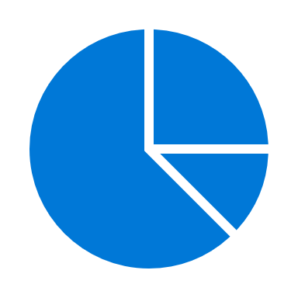



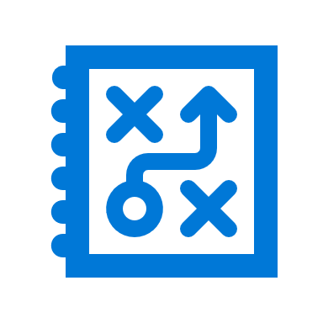



The evolving world of Analytics
Descriptive
Diagnostic
Predictive
Prescriptive
Cognitive
Notes:
TALKING POINTS
Descriptive Analytics
The world of analytics, is evolving from the typical “Descriptive Analytics”, which is all about – What is happening in my business?
Diagnostic Analytics
The data insights, provided by descriptive analytics, are needed to provide the answer to: , “Why it is happening in your business”, which is often referred to analyzing root cause, or “Diagnostic Analytics”
Both, Descriptive and Diagnostic Analytics, is seen as a workload which is primarily providing a reactive response --- from what is happening, why is it happening, to what I am I going to do about it?
Predictive Analytics
By building out predictive patterns on top of your data, by utilizing the data findings from Descriptive, Diagnostic and Predictive data, you’ll be able to identify whatis based on what you get from descriptive and diagnostic analytics and used to find answers to the question of what is likely to happen in the future based on previous trends and patterns?
Prescriptive Analytics
Techniques used to provide a predictive insights into your data, is commonly introduced by building out machine learning models, to “predict” trends and give the answer to the very
When you get the findings from Descriptive, Diagnostic and Predictive analytics like what’s happened, the root cause behind that and what-might-happen in future, Prescriptive model utilizes those answers to help you determine the best course of action to choose to bypass or eliminate future issues.
Cognitive Analytics
Cognitive analytics combines a number of intelligent technologies like artificial intelligence, machine-learning algorithms, deep learning etc.to apply human brain like intelligence to perform certain tasks. Basically, this type of analytics is inspired by how the human brain processes information, draws conclusions and codifies instincts and experience into learning such as understanding not only the words in a text but the full context of what is being written or spoken.
Source: https://www.weirdgeek.com/2018/11/types-of-analytics/
PRESENTER NOTES AND GUIDANCE
You may find that many of your attendees are simply not aware of the terminology. A good example to test this is to ask how many have heard of “Descriptive Analytics”? Follow this up by asking how many attendees have created a Data Warehouse and built historical reports against the Data Warehouse? Make a note of the difference of respondents between the two questions and confirm that this is one way that you can provide a solution to deliver descriptive analytics. Continue to present the remaining four types without audience participation. If you are not careful, a slide that is design to take two minutes, could take an hour. Understanding the different types are important as many of them can be implemented in a modern data warehouse.

Slide 18
Advanced Analytics patterns
Modern data warehouse
Advanced analytics
Real-time analytics
“Integrate all our data—including Big Data—with our data warehouse for analytics and reporting”
“Predict next best offer and customer churn”
“Derive insights from our devices and data streams in real-time”
Notes:
TALKING POINTS
Advanced Analytics is all about predictive workloads, common scenarios and usage patterns would focus on the trends and prediction of data.
There’s a few use cases we see a cross industries, it goes beyond the

Slide 19
Advanced Analytics patterns
Ingest & Prep
Model & Serve
Visualize
Azure Data Factory
Azure Synapse Analytics
(Data Warehouse)
Logs (unstructured)
Code-free data transformation and ingestion from 90+ data integration connectors
Up to 14x faster and costs 94% less than other cloud providers
Power BI
Media (unstructured)
Train
Leader in the Magic Quadrant for Business Intelligence and Analytics Platforms*
Azure Databricks
(Data prep)
Azure Databricks
(Machine Learning)
Up to 10x faster than vanilla Spark
Files (unstructured)
Up to 10x faster than vanilla Spark
Store
Business/ custom apps (structured)
Azure Data Lake Storage
High performance data lake available in all 54 Azure regions
Notes:
TALKING POINTS
A modern data warehouse lets you bring together all your data at any scale easily, and to get insights through analytical dashboards, operational reports, or advanced analytics for all your users as the foundation,
Advanced analytics introduces Azure Databricks - to shape the data formats and prep it using a Notebook—making internal collaboration on data more streamlined and efficient.

Slide 20
Real-time analytics patterns
Modern data warehouse
Advanced analytics
Real-time analytics
“Integrate all our data—including Big Data—with our data warehouse for analytics and reporting”
“Predict next best offer and customer churn”
“Derive insights from our devices and data streams in real-time”
Notes:
TALKING POINTS
One of the core patterns that customers are using today, is the use or need for real-time or near real-time analytical solutions. Real-time scenarios, are often more prominent in environments driven by sensors and devices, streaming data services and flows, with the ability to scale on demand, and ingestion to real-time or near-real time data pipelines.
A common architecture used in real-time scenarios is through the use of Event hubs (or real-time event- processing, or in IoT scenarios by the use of IoT Hubs to provide real-time streaming of data and the ability to control and manage the devices.

Slide 21


Real-time analytics patterns
Ingest & Prep
Model & Serve
Visualize
Azure Data Factory
Azure Synapse Analytics
(Data Warehouse)
Logs (unstructured)
Code-free data transformation and ingestion from 90+ data integration connectors
Up to 14x faster and costs 94% less than other cloud providers
Power BI
Media (unstructured)
Train
Leader in the Magic Quadrant for Business Intelligence and Analytics Platforms*
Azure Databricks
(Data prep)
Azure Databricks
(Machine Learning)
Up to 10x faster than vanilla Spark
Files (unstructured)
Streaming
Up to 10x faster than vanilla Spark
Streaming
Store
Business/ custom apps (structured)
Azure Data Lake Storage
Azure Event Hub
High performance data lake available in all 54 Azure regions
Sensors and IoT
Notes:
TALKING POINTS
A modern data warehouse lets you bring together all your data at any scale easily, and to get insights through analytical dashboards, operational reports, or advanced analytics for all your users as the foundation,
Advanced analytics introduces Azure Databricks - to shape the data formats and prep it using a Notebook—making internal collaboration on data more streamlined and efficient.

Slide 22
Demo: Exploring a Modern Data Warehouse
Notes:
DEMO INSTRUCTIONS
REVIEW THE DETAILED DEMO GUIDE FOR STEPS AND PREREQUISITES

Slide 23
The evolution of Cloud Scale Analytics
Notes:
Talking Points
Digital transformation & Data Estate Modernization, it’s the topic of the day, and for a good reason! It’s here to stay, It’s a phenomenon that is actively fueling both the success and the failure of every organization.

Slide 24

Azure
Synapse
Analytics
Limitless data warehouse with unmatched time to insights
PREVIEW
QUERY
On-premises data
Unified experience
Synapse Studio
Cloud data
Integration
Management
Monitoring
Security
Power BI
Devices data
Analytics Runtimes
SQL
On Demand
SQL Provisioned
Spark
Azure Machine Learning
SaaS data
STORE
Azure Data Lake Storage
Notes:
TALKING POINTS
Azure Synapse is a limitless analytics service, that brings together enterprise data warehousing and Big Data analytics. It gives you the freedom to query data on your terms, using either serverless on-demand or provisioned resources—at scale. Azure Synapse brings these two worlds together with a unified experience to ingest, prepare, manage, and serve data for immediate BI and machine learning needs.
We have taken the same industry leading data warehouse to a whole new level of performance and capabilities. Businesses can continue running their existing data warehouse workloads in production today with Azure Synapse and will automatically benefit from the new capabilities which are in preview. Businesses can put their data to work much more quickly, productively, and securely, pulling together insights from all data sources, data warehouses, and big data analytics systems

Slide 25
Azure Synapse Analytics
Limitless scale
Powerful insights
Unified experience
Unmatched security
Notes:
TALKING POINTS
Limitless Scale
Azure Synapse delivers insights from all your data, across data warehouses and big data analytics systems, with blazing speed. With Azure Synapse, data professionals can query both relational and non-relational data at petabyte-scale using the familiar SQL language.
Powerful Insights
We’ve deeply integrated with Power BI and Azure Machine Learning to greatly expand discovery of insights from all your data and apply machine learning models to all your intelligent apps. And You can significantly reduce project development time for BI and machine learning projects with a limitless analytics service that enables you to seamlessly apply intelligence over all your most important data, on one data model—from Dynamics 365 to semi-structured data in Office 365—
Unified Experience
Azure Synapse also provides a unified experience for data prep, data management, data warehousing, big data, and AI tasks. Data engineers can use a code-free visual environment for managing data pipelines. Database administrators can automate query optimization. Data scientists can build proofs of concept in minutes. Business analysts can securely access datasets and use Power BI to build dashboards in minutes—all while using the same analytics service.
Unmatched Security
Azure has the most advanced security and privacy features in the market. These features are built into the fabric of Azure Synapse, such as automated threat detection and always-on data encryption. And for fine-grained access control businesses can ensure data stays safe and private using column-level security, native row-level security, column-level encryption, as well as dynamic data masking to automatically protect sensitive data in real time.
Environment or workspace … avoid UI

Slide 26
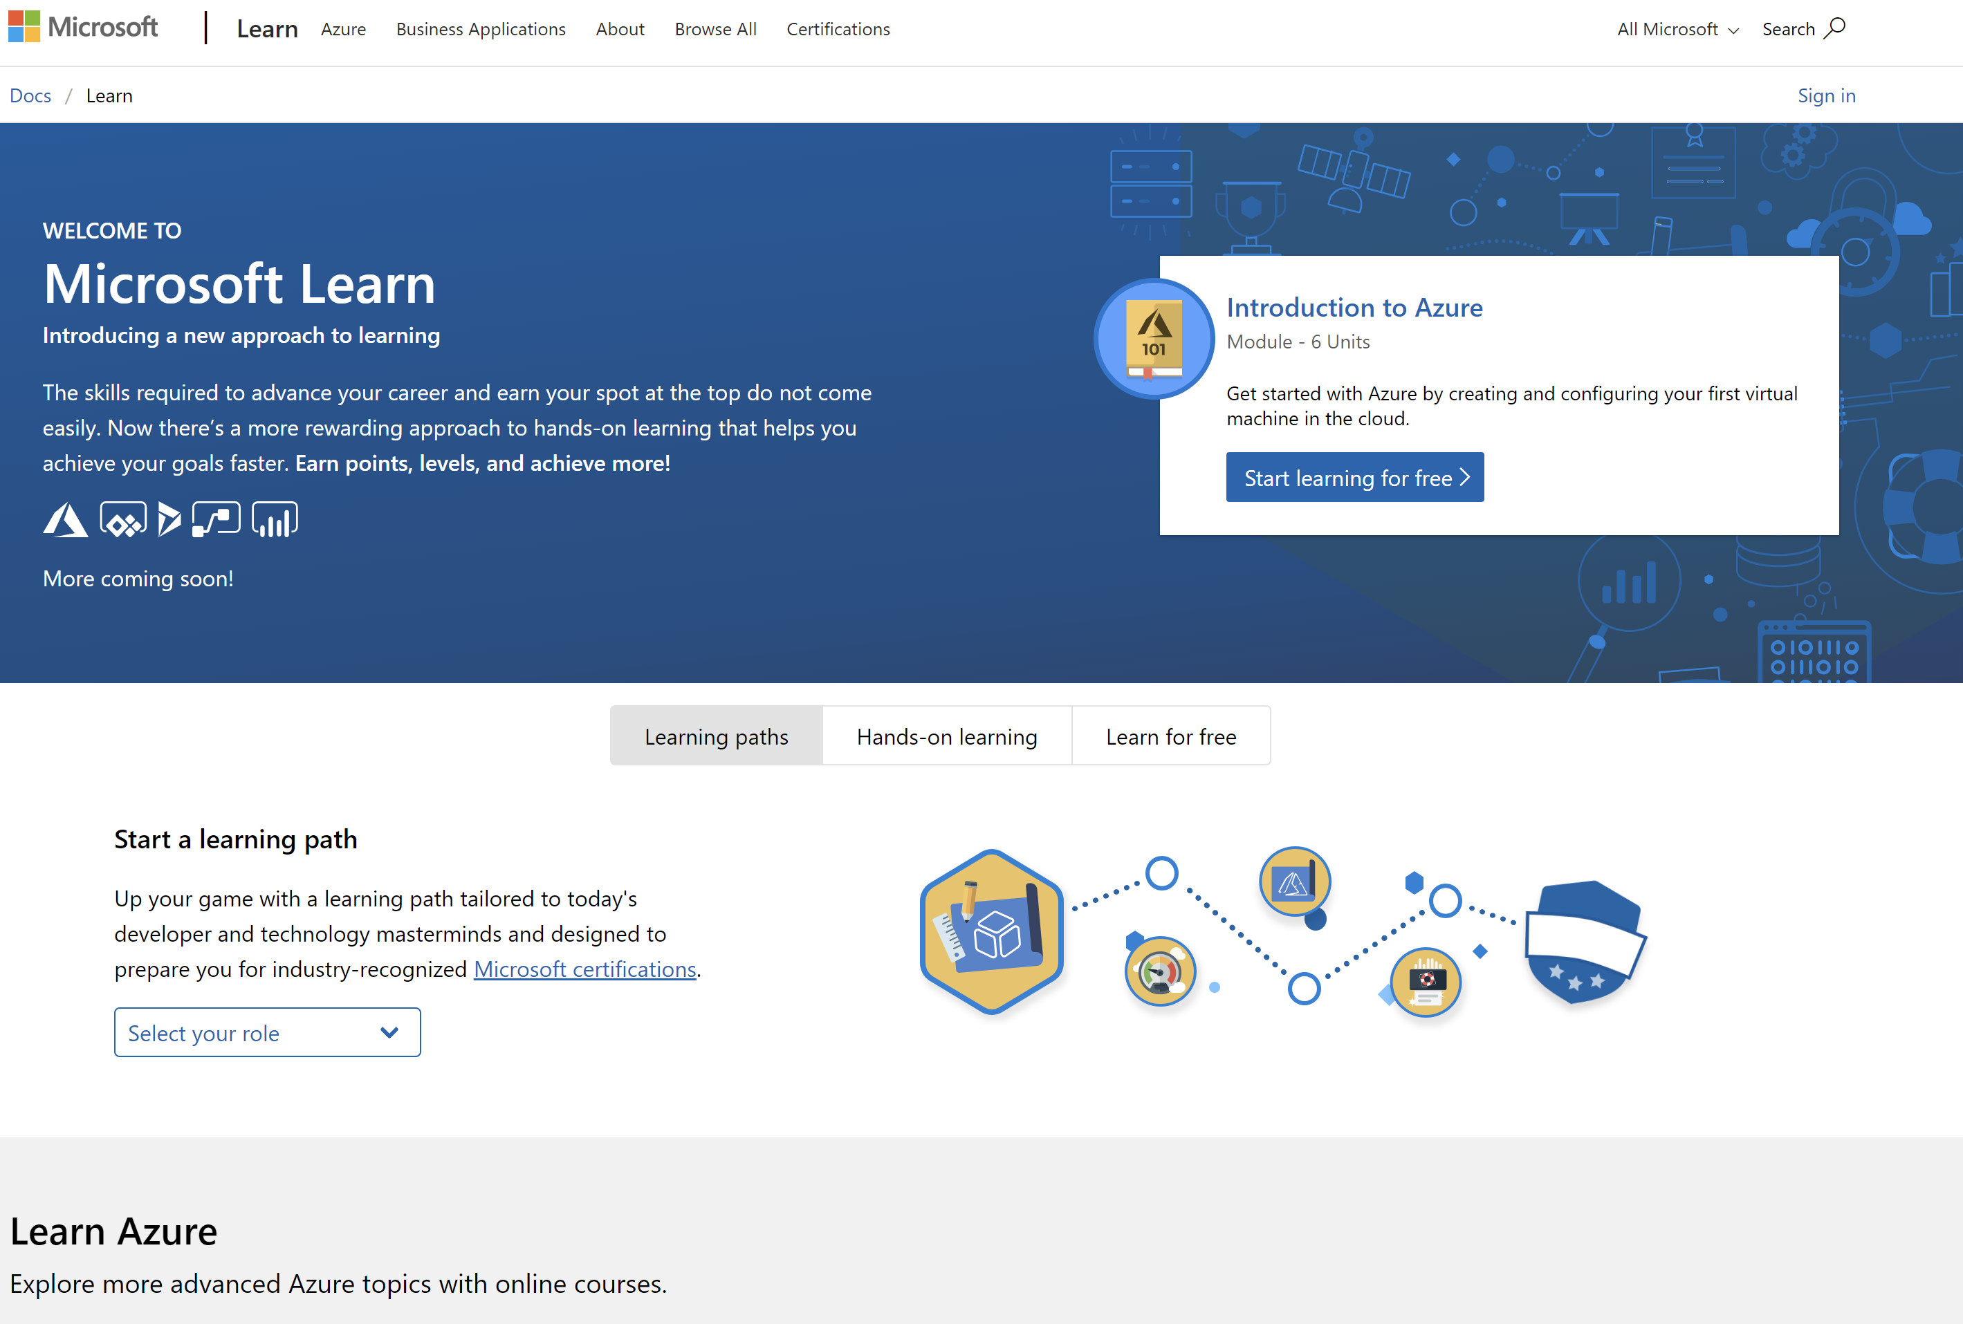
/MS Learn alert
Complete interactive learning exercises, watch videos, and practice and apply your new skills.
aka.ms/DATA10MSLearnCollection

Slide 27


Get Certified
Resources
Session Resources
aka.ms/DATA10
Session Code on GitHub
aka.ms/DATA10repo
All Event Resources
aka.ms/mymsignitethetour
aka.ms/azuredataengineer
#MSIgniteTheTour
Notes:
TALKING POINTS
As mentioned at the beginning of the session, we bundled all resources related to this session
As you probably learned from this session, the opportunities with modern data warehousing and cloud scale analytics are real, and there is an even bigger need and market demand for technically skilled people. Microsoft offers a set of role-based certifications, helping you in validating your skills in a dedicated role.
This Learning Path provides a step towards pursuing the Microsoft Certified: Azure Data Engineer Associate level certification.
The link to this certification, and the skills being measured on the certification exams associated with this role-based certifications are available for you here.

Slide 28
Designing a modern data warehouse solution
Speaker name
Title

